Slide 1
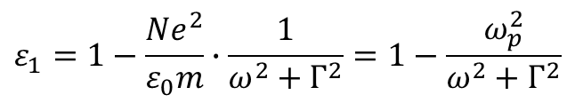

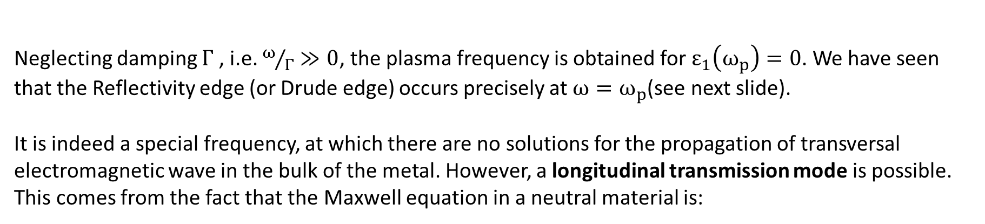

1.4.Plasmons, polaritons
The plasmon resonance
In the Drude – Zener model we have derived the dielectric function for free electrons and taking $ε_{opt}=1$ (no higher energy transitions):
$$ε_{1}=1−\frac{Ne^{2}}{ε_{0}m}∙\frac{1}{ω^{2}+Γ^{2}}=1−\frac{ω_{p}^{2}}{ω^{2}+Γ^{2}}$$
and have called the term $ω_{p}^{2}=\frac{Ne^{2}}{ε_{0}m}$ plasma frequency.
Neglecting damping $Γ$ , i.e. $ω/Γ≫0$, the plasma frequency is obtained for $ε_{1}\left(ω_{p}\right)=0$. We have seen that the Reflectivity edge (or Drude edge) occurs precisely at ${ω=ω}_{p}$(see next slide).
It is indeed a special frequency, at which there are no solutions for the propagation of transversal electromagnetic wave in the bulk of the metal. However, a longitudinal transmission mode is possible. This comes from the fact that the Maxwell equation in a neutral material is:
$$∇∙ε_{0}\tilde{ε}\vec{E}=0$$
For $\tilde{ε}≠0$ this means that $∇∙\vec{E}=0$ which leads to transversal waves. However if $\tilde{ε}=0$ , the Maxwell equation above can be satisfied with $∇∙\vec{E}≠0$ and allow longitudinal waves.

Slide 2
Reflectance spectra of some common metals
Reflectance (R)
Paquin R. Properties of metals. In: Bass M, Stryland EW, Williams DR, Wolfe WL Handbook of Optics, Volume II: Devices, Measurements, and Properties.Vol 2. second. McGraw-Hill; 1995:35.1-35.78.

Slide 3
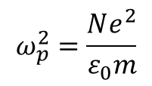
A bulk plasmon oscillation is a collective longitudinal excitations of a free electron gas
E
+
k_{vp}
$$ω_{p}^{2}=\frac{Ne^{2}}{ε_{0}m}$$
N…electron density
e…elementary charge
m…electron mass

Slide 4
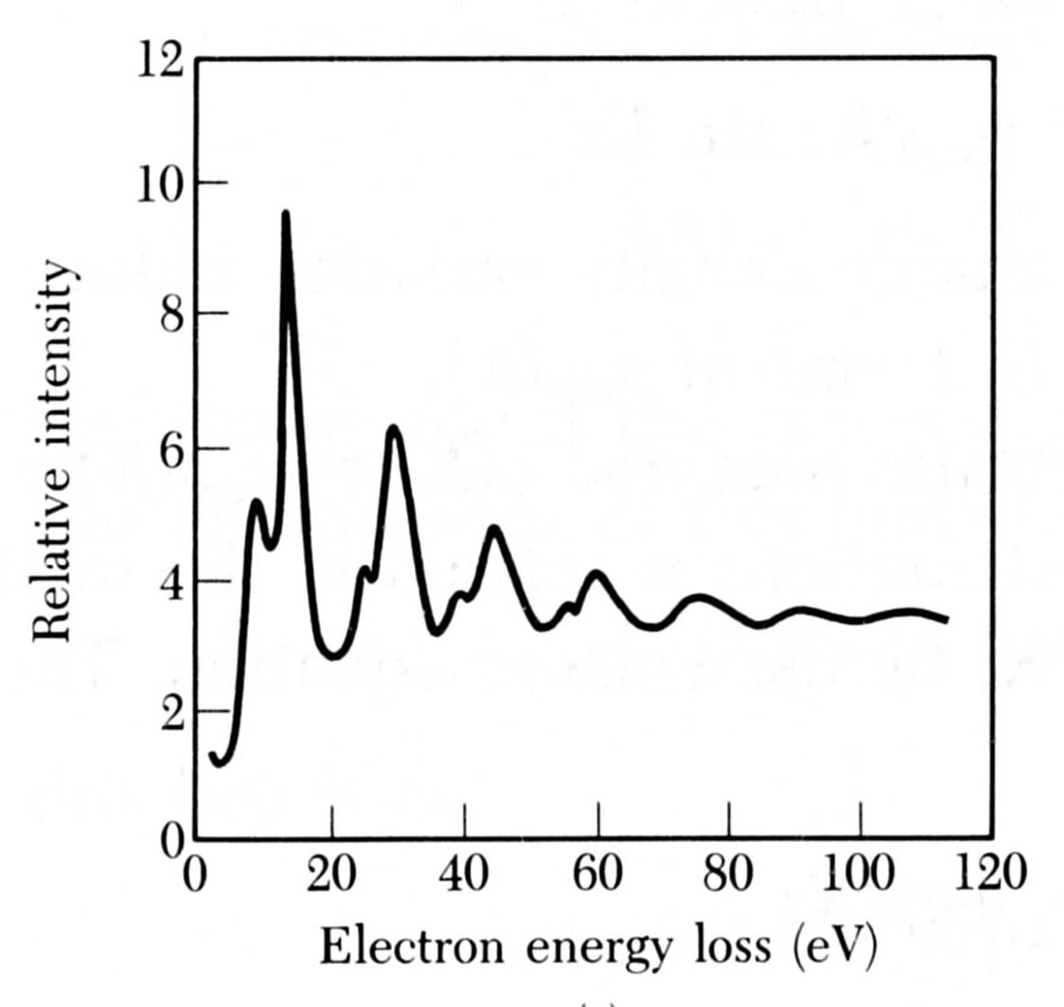
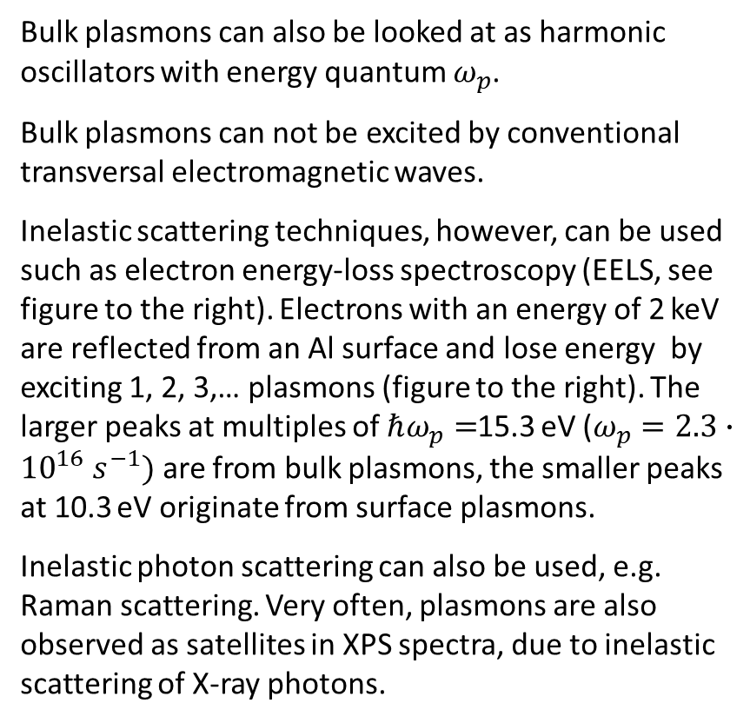
The detection of “bulk” plasmons
Bulk plasmons can also be looked at as harmonic oscillators with energy quantum $ω_{p}$.
Bulk plasmons can not be excited by conventional transversal electromagnetic waves.
Inelastic scattering techniques, however, can be used such as electron energy-loss spectroscopy (EELS, see figure to the right). Electrons with an energy of 2 keV are reflected from an Al surface and lose energy by exciting 1, 2, 3,… plasmons (figure to the right). The larger peaks at multiples of $ℏω_{p}=$15.3 eV ($ω_{p}=2.3∙{10}^{16} s^{−1})$ are from bulk plasmons, the smaller peaks at 10.3 eV originate from surface plasmons.
Inelastic photon scattering can also be used, e.g. Raman scattering. Very often, plasmons are also observed as satellites in XPS spectra, due to inelastic scattering of X-ray photons.
1
2
3
4
5
C.J. Powell, J. B. Swan, Phys. Rev. 115, 869 1959

Slide 5

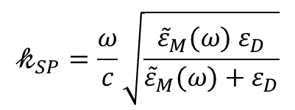



Surface plasmons (or surface plasmon-polaritons) can be excited by photons (but only using a trick)
Surface plasmons are waves propagating along the surface of a metal and have both transversal and longitudinal field components that decay exponentially along the direction perpendicular to the surface. On the metallic side, the wave is confined by the skin depth, on the side of the dielectric the wave is evanescent, similarly to the case of total reflection.
Surface plasmons have a particular dispersion relation $𝓀_{SP}$ that makes it impossible to use an electromagnetic wave directly for exciting the surface plasmon.
$$𝓀_{free}=\frac{ω}{c}\sqrt{ε_{D}}$$
$$ε_{D}$$
$$𝓀_{SP}=\frac{ω}{c}\sqrt{\frac{{\tilde{ε}}_{M}(ω){ ε}_{D}}{{\tilde{ε}}_{M}(ω)+ε_{D}}}$$
$${\tilde{ε}}_{M}$$

Slide 6
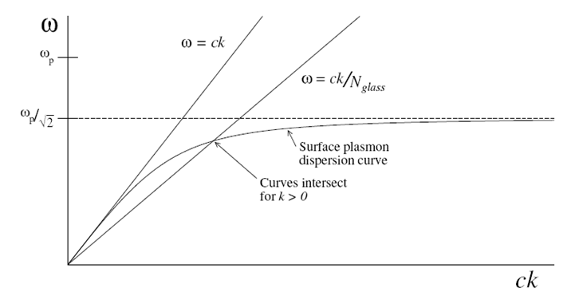
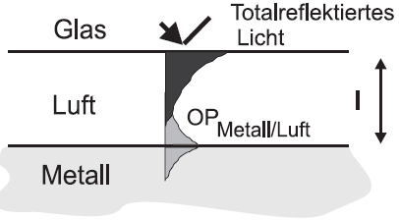
Excitation of surface plasmons with light (only p polarized light)
strongly bound
Otto configuration
glass
total reflection
air
surface plasmon wave travelling along the interface
weakly bound
metal
Kretschmann-Raether configuration
Surface gratings
glass
metallic reflection
metal
air
surface plasmon wave travelling along the interface

Slide 7
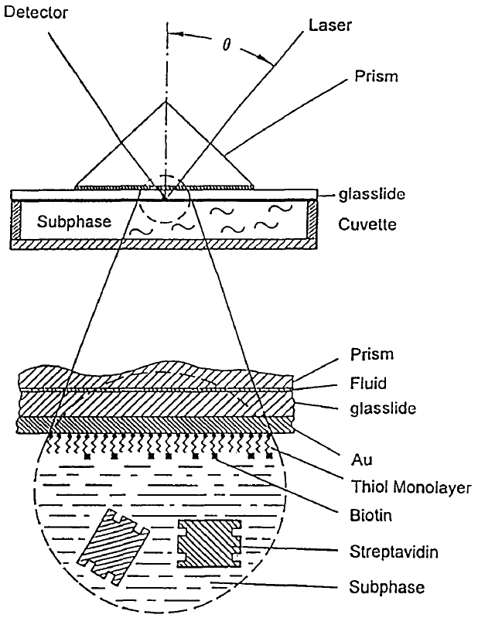
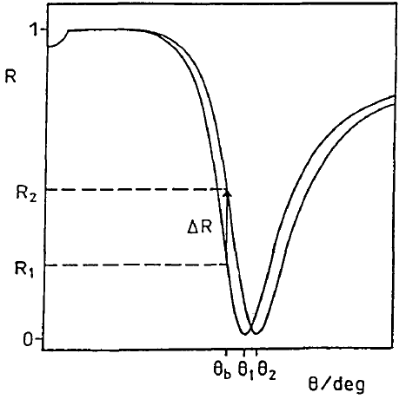
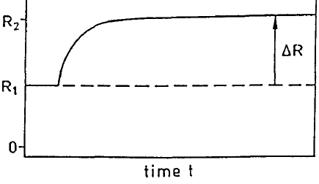

Application: surface plasmon spectroscopy (it is the fundamental principle behind many color-based biosensor applications)
$${𝓀_{0}n_{I}\sin\left(θ\right)=𝓀_{∥=}𝓀}_{SP}$$
K. Matsubara, S. Kawata, S. Minami
APPLIED OPTICS, 27, 6 (1988)
Knoll, et.al. Biosensors & Bioelectronics, 1995, 10, 903

Slide 8

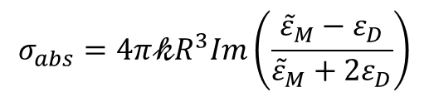
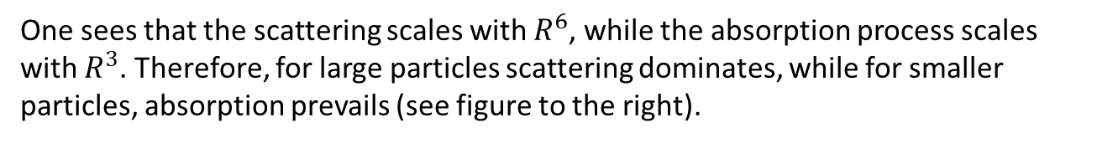
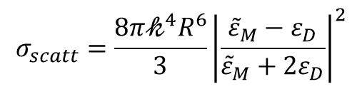
Localized plasmons on metal nanoparticles
For small metallic particles in the 10-20 nm range the clear distinction between surface and bulk plasmon vanishes. The coherently shifted electrons together with the restoring field represent an oscillator (similar to a very large chromophore).
Rayleigh approximation ($λ≫R)$:
For the scattering and absorption cross sections of nanospheres:
$$σ_{scatt}=\frac{8{π𝓀}^{4}R^{6}}{3}{\left|\frac{{\tilde{ε}}_{M}−ε_{D}}{{\tilde{ε}}_{M}+{2ε}_{D}}\right|}^{2}$$
sphere of radius R
$$σ_{abs}=4π𝓀R^{3}Im\left(\frac{{\tilde{ε}}_{M}−ε_{D}}{{\tilde{ε}}_{M}+{2ε}_{D}}\right)$$
One sees that the scattering scales with $R^{6}$, while the absorption process scales with $R^{3}$. Therefore, for large particles scattering dominates, while for smaller particles, absorption prevails (see figure to the right).
M. A. van Dijk et al., Phys. Chem. Chem. Phys., 2006, 8, 3486–3495

Slide 9
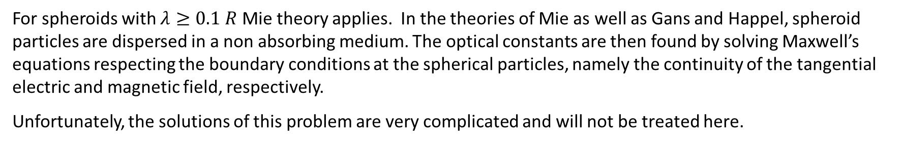
For spheroids with $λ≥0.1 R$ Mie theory applies. In the theories of Mie as well as Gans and Happel, spheroid particles are dispersed in a non absorbing medium. The optical constants are then found by solving Maxwell’s equations respecting the boundary conditions at the spherical particles, namely the continuity of the tangential electric and magnetic field, respectively.
Unfortunately, the solutions of this problem are very complicated and will not be treated here.
Qualitatively, the resonance position of the scattering and absorption cross section depend both on the particle size and the dielectric constant of the surrounding dielectrics.
To the right, experimental (full line) and simulated (Mie, dotted line) spectra of Ag and Sn nanoparticles of different sizes are given. We see that both, the size as well as the dielectric constant of the environment influence the scattering peak position.
D. Gaspar et al., Plasmonics, 9, 1015, (2014)

Slide 10
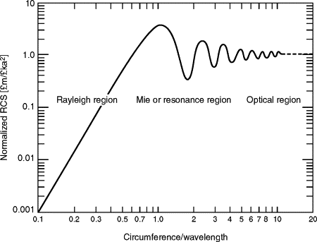

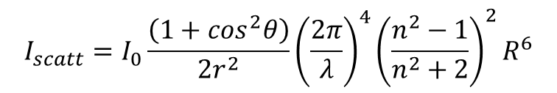



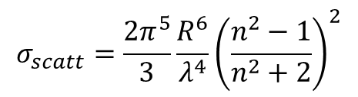
Some final considerations on scattering
In Rayleigh scattering forward scattering equals back scattering according to:
$$I_{scatt}=I_{0}\frac{\left(1+\cos^{2}θ\right)}{2r^{2}}{\left(\frac{2π}{λ}\right)}^{4}{\left(\frac{n^{2}−1}{n^{2}+2}\right)}^{2}R^{6}$$
integrating
$$σ_{scatt}=\frac{2π^{5}}{3}\frac{R^{6}}{λ^{4}}{\left(\frac{n^{2}−1}{n^{2}+2}\right)}^{2}$$
There is a strong scattering at $θ=90°$ (blue sky).
For Mie scattering, forward scattering dominates (white halo around the sun).
$$θ$$
$$σ_{sphere}/πR^{2}$$
$$2πR/λ$$

Slide 11
Effect of particle morphology on the scattering properties
Au
Au
Y. Zheng et al., Nanoscale, 5, 788, 2013
(A–G) TEM images of Au nanorod samples 1–7, respectively. (H) Extinction spectra of the Au nanorod solutions. (I) Photograph of the Au nanorod solutions. From left to right are Au nanorod samples 1–7.

Slide 12
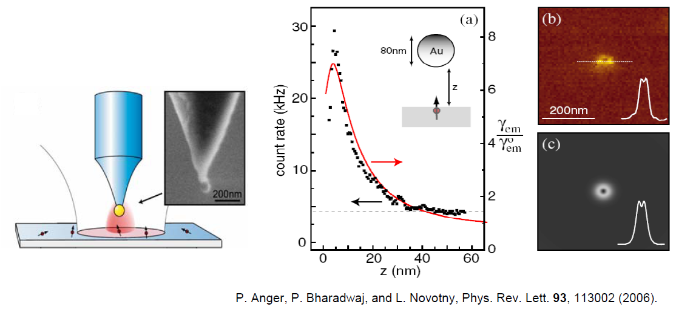
Local field enhancement of single molecule fluorescence by a gold nanosphere
Nile blue dyes coated on a glass substrate and covered by a thin PMMA coating

Slide 13
Applications of «Plasmonics»
Plasmon enhanced fluorescence and excitation: generally the peak of excitation wavelength differs from the peak of emission wavelength. By taking advantage of double plasmon wavelengths e.g. for an Au nanorod structure, a maximum enhancement of excitation and emission can be achieved (enhancement factor of 10-20, S.Y. Liu et al, J. Phys. Chem. C 117, 10636−10642, 2013).
Plasmon enhanced solar cells
Surface enhanced Raman scattering (SERS) and tip-enhanced Raman scattering (TERS) can reach single molecule detection, which is remarkable given the inherently low scattering cross-section (S.M. Nie et al., Science, 275 1102, 1997).
Heat generation of thermo-plasmonics (photothermal melting, photoacousics, photothermal imaging, cancer therapy, drug delivery, catalysis)

